Slide 1
Emotion-Based Fan Speed Control System Using Facial Expression Recognition
TEAM MEMBERS:
Under the esteemed guidance of :
GUIDE NAME, DESIGNATION

Slide 2
Problem Identification
Traditional fan systems work only with manual control and cannot understand the user’s emotional state.
This creates inconvenience because the fan speed does not adjust automatically according to the person’s mood.
To overcome this, the proposed system detects facial emotion using a camera and Python code, then controls the fan speed and LED indication automatically.

Slide 3
Motivation Behind The Project
The motivation behind this project is to make everyday appliances smarter and more user-friendly by connecting human emotions with automatic control systems.
By detecting facial emotions and adjusting fan speed accordingly, the system improves comfort, reduces manual effort, and introduces an intelligent way of human-machine interaction..

Slide 4
Objectives
To detect human facial emotions using a camera.
To process the detected emotion using Python code.
To send the emotion result to Arduino for control action.
To control fan speed automatically based on emotion.
To indicate the detected emotion using LEDs.
To display system status on the LCD.
To develop an intelligent and user-friendly automation system.

Slide 5
Introduction
Automation is making modern systems more intelligent and responsive to human needs.
This project presents an emotion-based fan speed control system that uses facial expression recognition to operate a fan automatically.
A camera captures the user’s face, Python detects the emotion, and Arduino adjusts the fan speed with LED indication.
The system creates a simple link between human emotion and appliance control, improving comfort and making the setup more interactive.

Slide 6
Literature Survey
S.no | Author | Title | Problem | Summary
1 | Hadjar, H., et al. | TheraSense | Difficult to detect emotion accurately in real time from video. | Proposed a deep learning system for real-time facial emotion recognition in teleconsultation.
2 | Bai, M., et al. | Lightweight Emotion Analysis Solution Using TinyML | Existing models are too heavy for embedded devices. | Developed a lightweight TinyML model for facial emotion recognition on portable devices.
3 | Sone, Y., et al. | Control Support System for Smart Homes | Smart homes lack personalized automatic control. | Presented an intelligent smart home control system based on user-interest analysis.
4 | Addow, M. A., et al. | Low-Cost IoT-Based Smart Home Automation System | Smart automation is often costly. | Designed a low-cost IoT system for appliance automation and monitoring.
5 | Aleran, A., et al. | AI and IoT in Energy Preservation | Energy wastage remains high in automated systems. | Reviewed how AI and IoT improve energy-efficient appliance control.

Slide 7
Existing System
In the existing system, fan speed is controlled manually using switches or regulators. Some automatic systems use temperature sensors or timer-based control, but they do not consider the user’s emotional condition. These systems only respond to fixed inputs and cannot provide personalized comfort.
Disadvantages of Existing System:
Requires manual operation
No emotion recognition capability
Cannot provide personalized control
Less intelligent and less interactive
May lead to unnecessary power usage
Does not improve user comfort based on mood

Slide 8
Proposed System
The proposed system uses a camera to capture the user’s facial expression in real time.
The captured image is processed using Python-based emotion detection to identify emotions such as anger, happy, and sad. The detected emotion is then sent to the Arduino Uno, which acts as the main control unit.
Based on the emotion received, the Arduino controls the fan speed through a motor driver and turns ON the corresponding LED indicator.
In this system, anger makes the fan run at high speed with red LED ON, sad makes the fan run at medium speed with yellow LED ON, and happy keeps the fan OFF with green LED ON.
The LCD display shows the detected emotion and current system status, making the system smart, automatic, and user-friendly.

Slide 9
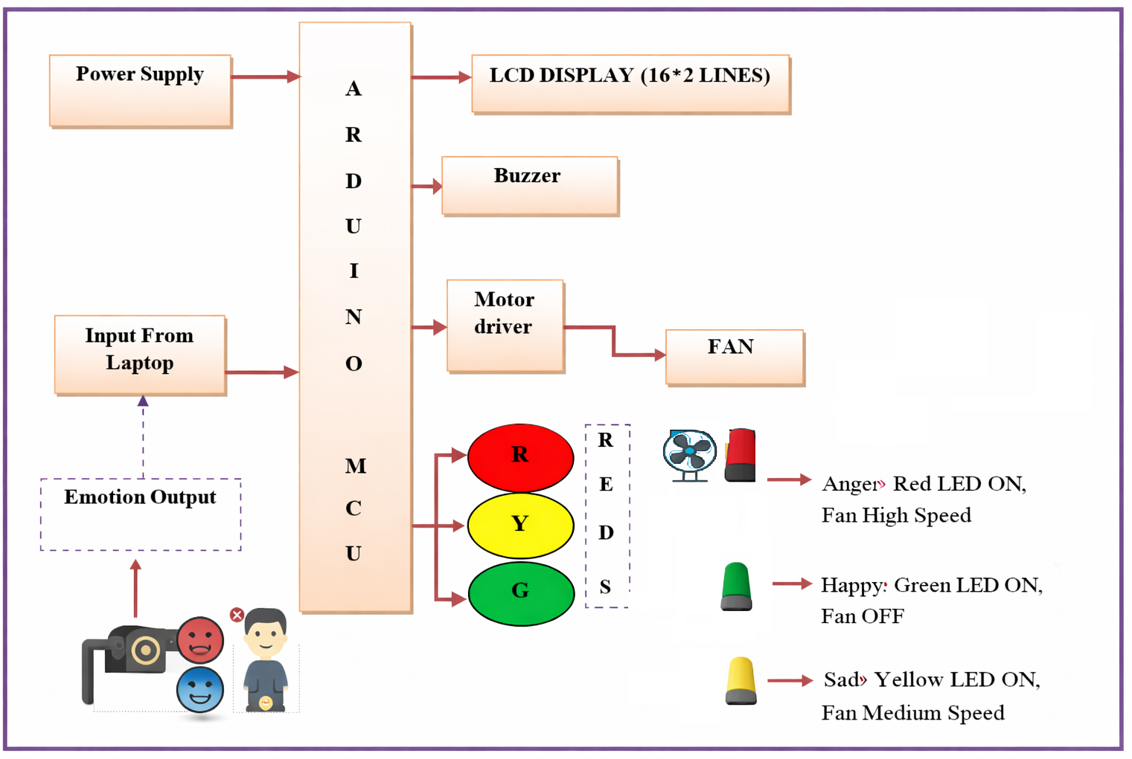
Block Diagram

Slide 10
Operation
The system starts by capturing the user’s face through a camera. The facial image is processed in Python to detect the current emotion.
Based on the detected result, a signal is sent to the Arduino Uno. The Arduino then controls the fan speed and LED indication accordingly.
If anger is detected, the red LED turns ON and the fan runs at high speed.
If sad is detected, the yellow LED turns ON and the fan runs at medium speed.
If happy is detected, the green LED turns ON and the fan remains OFF. The LCD display shows the detected emotion and system status in real time.

Slide 11
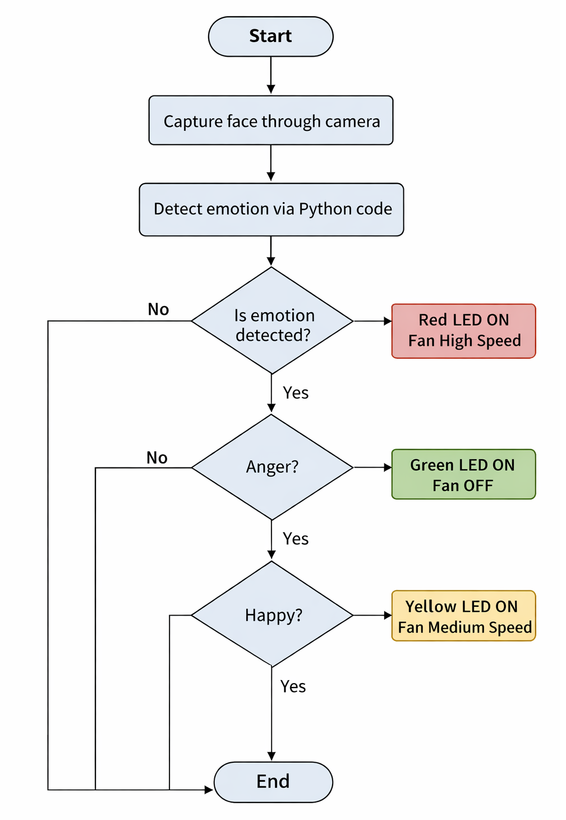
Implementation Flow chart

Slide 12
Hardware Details
Laptop Camera
Laptop Arduino Uno
Motor Driver Module
DC Fan
LCD Display
Red LED
Green LED
Yellow LED
Power Supply
Connecting Wires
Breadboard

Slide 13
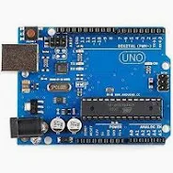
ESP 32 Microcontroller
Arduino Uno serves as the main controller of the system. It receives the emotion data and controls the fan speed, LEDs, and LCD display accordingly.
Specifications
Operating Voltage: 5 Volts.
Input Voltage: 7 to 20 Volts.
Digital I/O Pins: 14 (of which 6 can provide PWM output)
Analog Input Pins: 6.

Slide 14
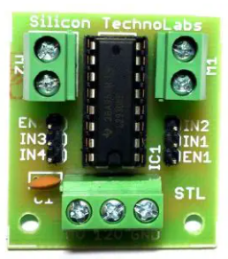
Motor Driver (L293d)
L293D is a basic motor driver integrated chip (IC) that enables us to drive a DC motor in either direction and also control the speed of the motor. The L293D is a 16 pin IC, with 8 pins on each side, allowing us to control the motor. It means that we can use a single L293D to run up to two DC motors. These act as an interface between the microcontroller and DC motors. They boost the low-power control signals to drive the motors safely.
Specifications
Wide Supply-Voltage Range: 4.5 V to 36 V
Separate Input-Logic Supply
Internal ESD Protection
High-Noise-Immunity Inputs
Output Current 600 mA Per Channel

Slide 15
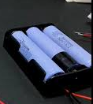
Battery Power Supply
A power supply is an electrical device that supplies electric power to an electrical load. The main purpose of a power supply is to convert electric current from a source to the correct voltage, current, and frequency to power the load. Provides stable power to the entire robot, including sensors, motors, and the ESP32 board, ensuring continuous operation in the field.
Specifications
Power Required By ESP32.
Components Required:
3.7V to 5V Step-Up Boost Converter Module.
Input 1-1.5V, output 5V 40-100mA.
Input 1.5-2V, output 5V 100-150mA.
Input 2-3V, output 5V 150-380mA.

Slide 16
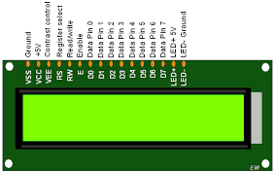
LCD 16X2 DISPLAY
LCD stands for liquid crystal display, which is used to show the status of an application, displaying values, debugging a program, etc..
A 16x2 LCD means it can display 16 characters per line and there are 2 such lines. In this LCD each character is displayed in 5x7 pixel matrix.
The 16 x 2 intelligent alphanumeric dot matrix display is capable of displaying 224 different characters and symbols.
This LCD has two registers, namely, Command and Data.
Specifications
This 16 × 2 LCD packs 32 characters into an outline smaller than that of most two-line displays.
An LED backlight enables optimal viewing in all lighting conditions.

Slide 17
Software Details
Arduino IDE
Embedded C
ESP32 Wi-Fi & IoT Libraries
Motor Driver Interface Library
IOT

Slide 18
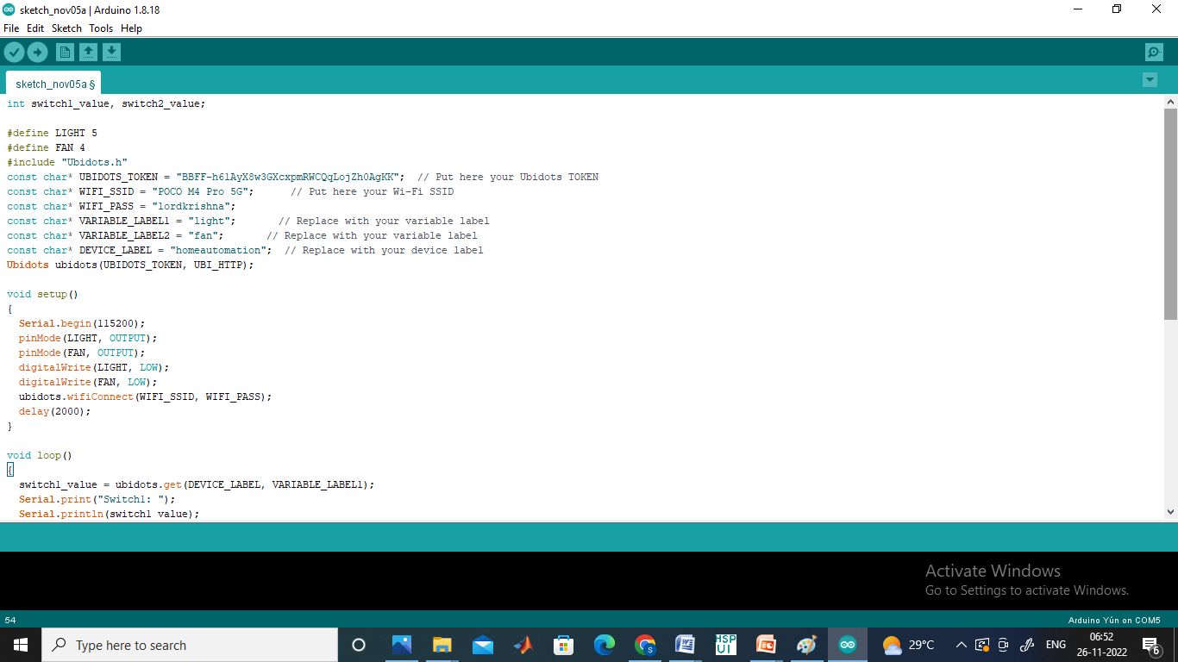
Arduino IDE
To Program the Atmega328 Microcontroller we used this IDE.
Arduino microcontrollers are pre-programmed with a boot loader that simplifies the uploading of programs to the on-chip flash memory.
The default boot loader of the Arduino UNO is the boot-loader.
Boards are loaded with program code via a serial connection to another computer.

Slide 19
Advantages
Automatic fan speed control
Reduces manual effort
Improves user comfort
Smart and interactive system
Real-time emotion detection
Easy to implement
Low-cost automation setup
Useful for intelligent home applications

Slide 20
Applications
Smart homes
Personal comfort systems
Intelligent room automation
Human-machine interaction systems
Healthcare and patient care rooms
Stress-aware environments
Smart office cabins
Emotion-based appliance control systems

Slide 21
Conclusion
The emotion-based fan speed control system provides a smart and automatic way to control fan operation using facial emotion recognition. By combining a camera, Python-based emotion detection, and Arduino control, the system adjusts fan speed based on the user’s emotional state. This improves comfort, reduces manual work, and makes the system more interactive and intelligent. The project shows how emotion recognition can be connected with home automation in a simple and effective way.

Slide 22
Future scope
In future, the system can be improved by detecting more emotions with higher accuracy. It can be connected to IoT platforms for remote monitoring and control. The project can also be extended to control multiple home appliances such as lights, air conditioners, and alarms based on user emotion. With advanced AI models and better sensors, the system can become more efficient, reliable, and suitable for real-world smart home applications.

Slide 23
References
Hadjar, H., et al. “TheraSense: Deep Learning for Facial Emotion Analysis in Teleconsultation.” Electronics, vol. 14, no. 3, 2025, Article 422.
Bai, M., et al. “Lightweight Emotion Analysis Solution Using Tiny Machine Learning.” Computers & Electrical Engineering, 2025.
Sone, Y., et al. “Development of a Control Support System for Smart Homes.” Robomech Journal, 2025.
Addow, M. A., et al. “A Low-Cost IoT-Based Smart Home Automation System for Urban Environments.” Discover Internet of Things, 2025.
Aleran, A., et al. “Artificial Intelligence and the Internet of Things in Energy Preservation.” Computing, 2025.

Slide 24
Thank you

